Slide 1
ISING MODEL
This was designed to model the magnetic behavior of spin lattices.
But in past few years, it was found that this has potential to model various social, business, medical, Computer Science problems.
This is a vastly used model to study many-body interaction problems where they have choice to make based on certain condition. For ex. : Modelling an election: How voters decide to vote based on neighbor's influence as well as their own need and priority.

Slide 2
TABLE OF CONTENT
ABOUT / DEFINITION : (MATHEMATICAL – LAYMEN/UNDERSTANDABLE) DONE
MATHEMATICS -DONE
ALGORITHMS -DONE
APPLICATIONS
EXPLAINATION OF ALGORITHMS
MARKOV CHAIN (GENERATING FAVOURABLE SAMPLES) DONE
METROPLIS ALGORITHM -DONE
WOLF CLUSTER ALGORITHM
USE IN OTHER FIELDS

Slide 3
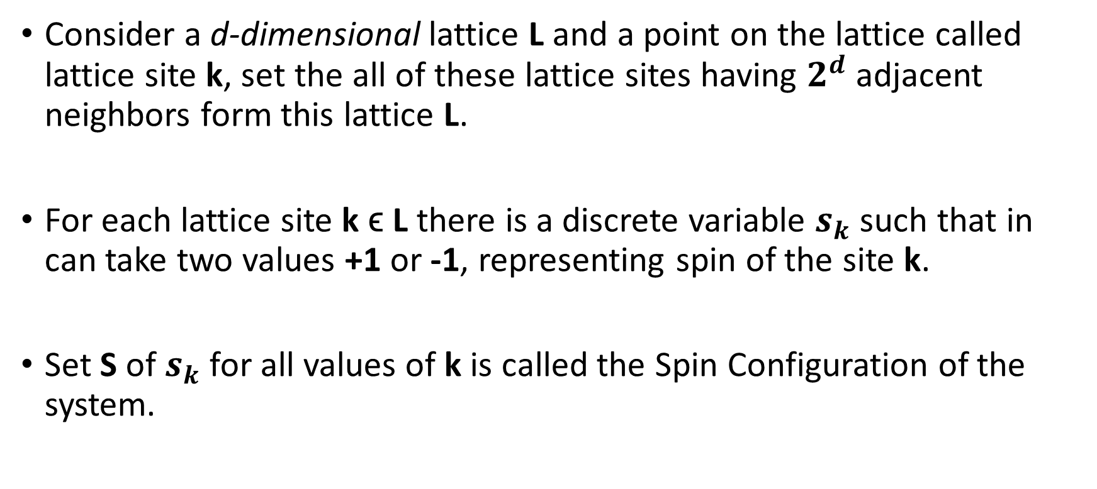
ISING MODEL : DEFINITION
Consider a d-dimensional lattice L and a point on the lattice called lattice site k, set the all of these lattice sites having $2^{d}$ adjacent neighbors form this lattice L.
For each lattice site k ϵ L there is a discrete variable $s_{k}$ such that in can take two values +1 or -1, representing spin of the site k.
Set S of $s_{k}$ for all values of k is called the Spin Configuration of the system.

Slide 4
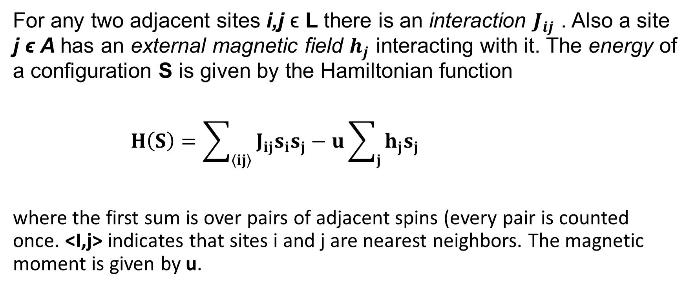
INTERACTION IN ISING MODEL
For any two adjacent sites i,j ϵ L there is an interaction $J_{ij}$ . Also a site j ϵ A has an external magnetic field $h_{j}$ interacting with it. The energy of a configuration S is given by the Hamiltonian function
$H\left(S\right)=\sum_{\left\langle ij\right\rangle }{J_{ij}s_{i}s_{j}}−u\sum_{j}{h_{j}s_{j}}$
where the first sum is over pairs of adjacent spins (every pair is counted once. <I,j> indicates that sites i and j are nearest neighbors. The magnetic moment is given by u.

Slide 5
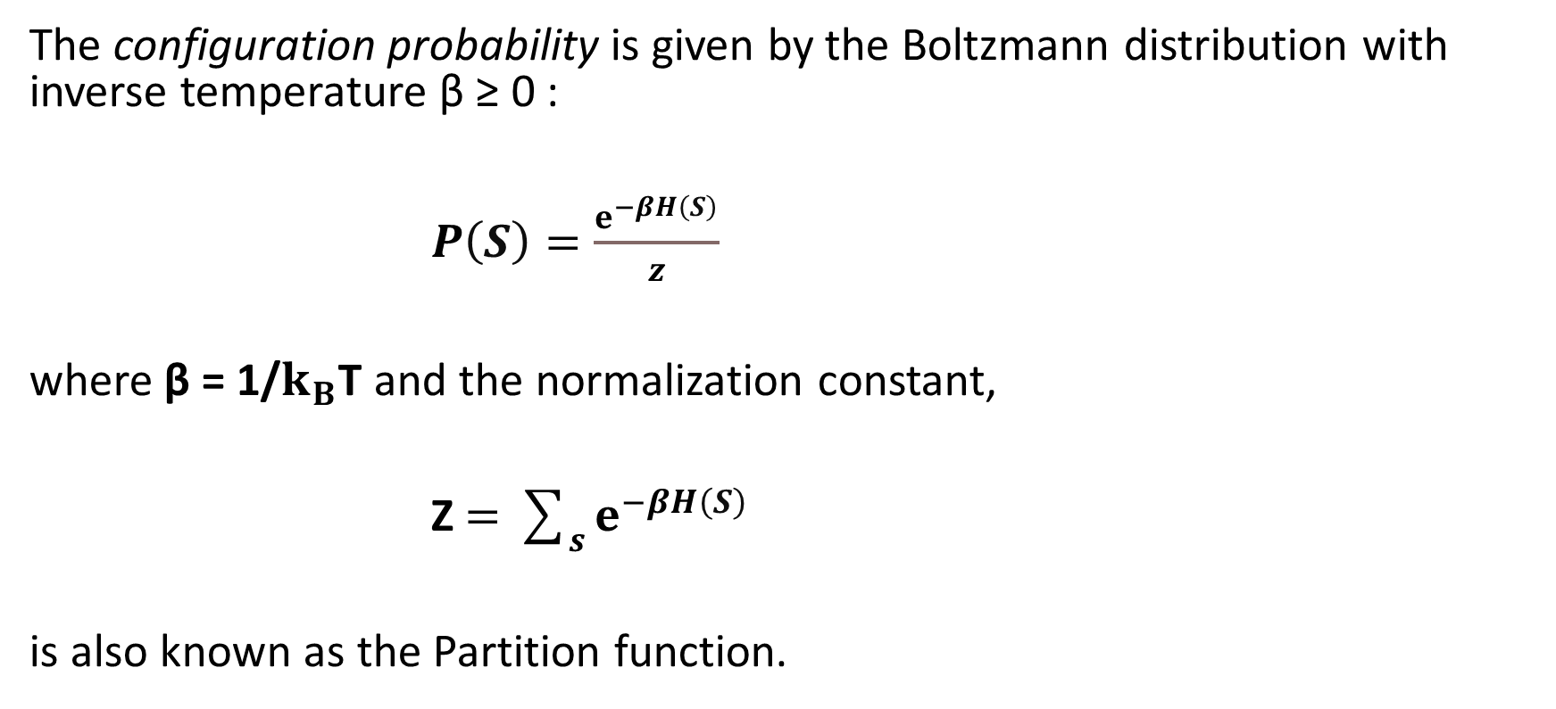
BOLTZMANN STATITISTICS AND PROBABILITY
The configuration probability is given by the Boltzmann distribution with inverse temperature β ≥ 0 :
$P\left(S\right)=\frac{ⅇ^{−βH\left(S\right)}}{z}$
where β = 1/$k_{B}$T and the normalization constant,
Z$=\sum_{s}{ⅇ^{−βH\left(S\right)}}$
is also known as the Partition function.

Slide 6

REAL LIFE MODELLING
Suppose an is being performed in a classroom. Every student has to vote whether to choose candidate as the CR or not.
As they are freshmen they don’t know each other much so they vote for candidate(A) who has talked to everyone and hosted 1-2 class get-togethers.
On Day 1 : Every will vote for the guy A.
But as days pass by opinion of few students will change due some bad incident with candidate A.
This distribution of Yes or No will be so random after a long time.
Students change their vote from Yes to No or the other way based on their personal experience or they may get influence by their close friends.
Yes
or
No

Slide 7
OBSERVABLES
AVERAGE MAGNETIZATION :
AVERAGE ENERGY :
HEAT CAPACITY :
SUSCEPTIBILITY :

Slide 8
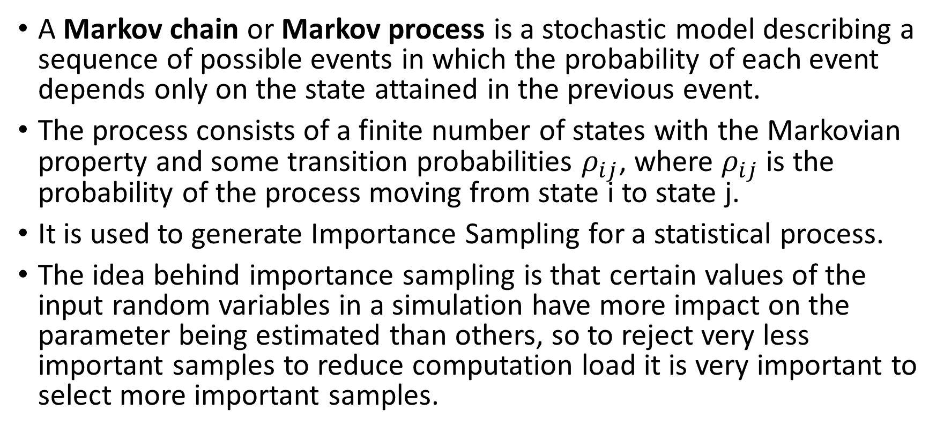
MARKOV CHAIN
A Markov chain or Markov process is a stochastic model describing a sequence of possible events in which the probability of each event depends only on the state attained in the previous event.
The process consists of a finite number of states with the Markovian property and some transition probabilities $ρ_{ij}$, where $ρ_{ij}$ is the probability of the process moving from state i to state j.
It is used to generate Importance Sampling for a statistical process.
The idea behind importance sampling is that certain values of the input random variables in a simulation have more impact on the parameter being estimated than others, so to reject very less important samples to reduce computation load it is very important to select more important samples.

Slide 9
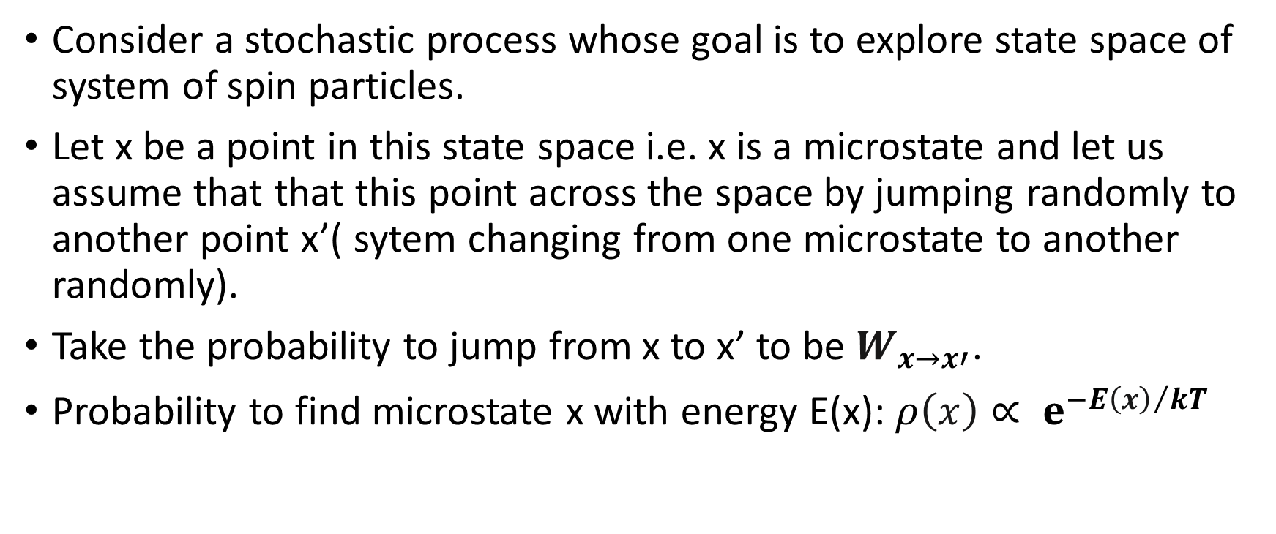
MARKOV CHAIN AND DETAILED BALANCE
Consider a stochastic process whose goal is to explore state space of system of spin particles.
Let x be a point in this state space i.e. x is a microstate and let us assume that that this point across the space by jumping randomly to another point x’( sytem changing from one microstate to another randomly).
Take the probability to jump from x to x’ to be $W_{x→x′}$.
Probability to find microstate x with energy E(x): $ρ\left(x\right)∝ ⅇ^{−E{\left(x\right)}/kT}$

Slide 10
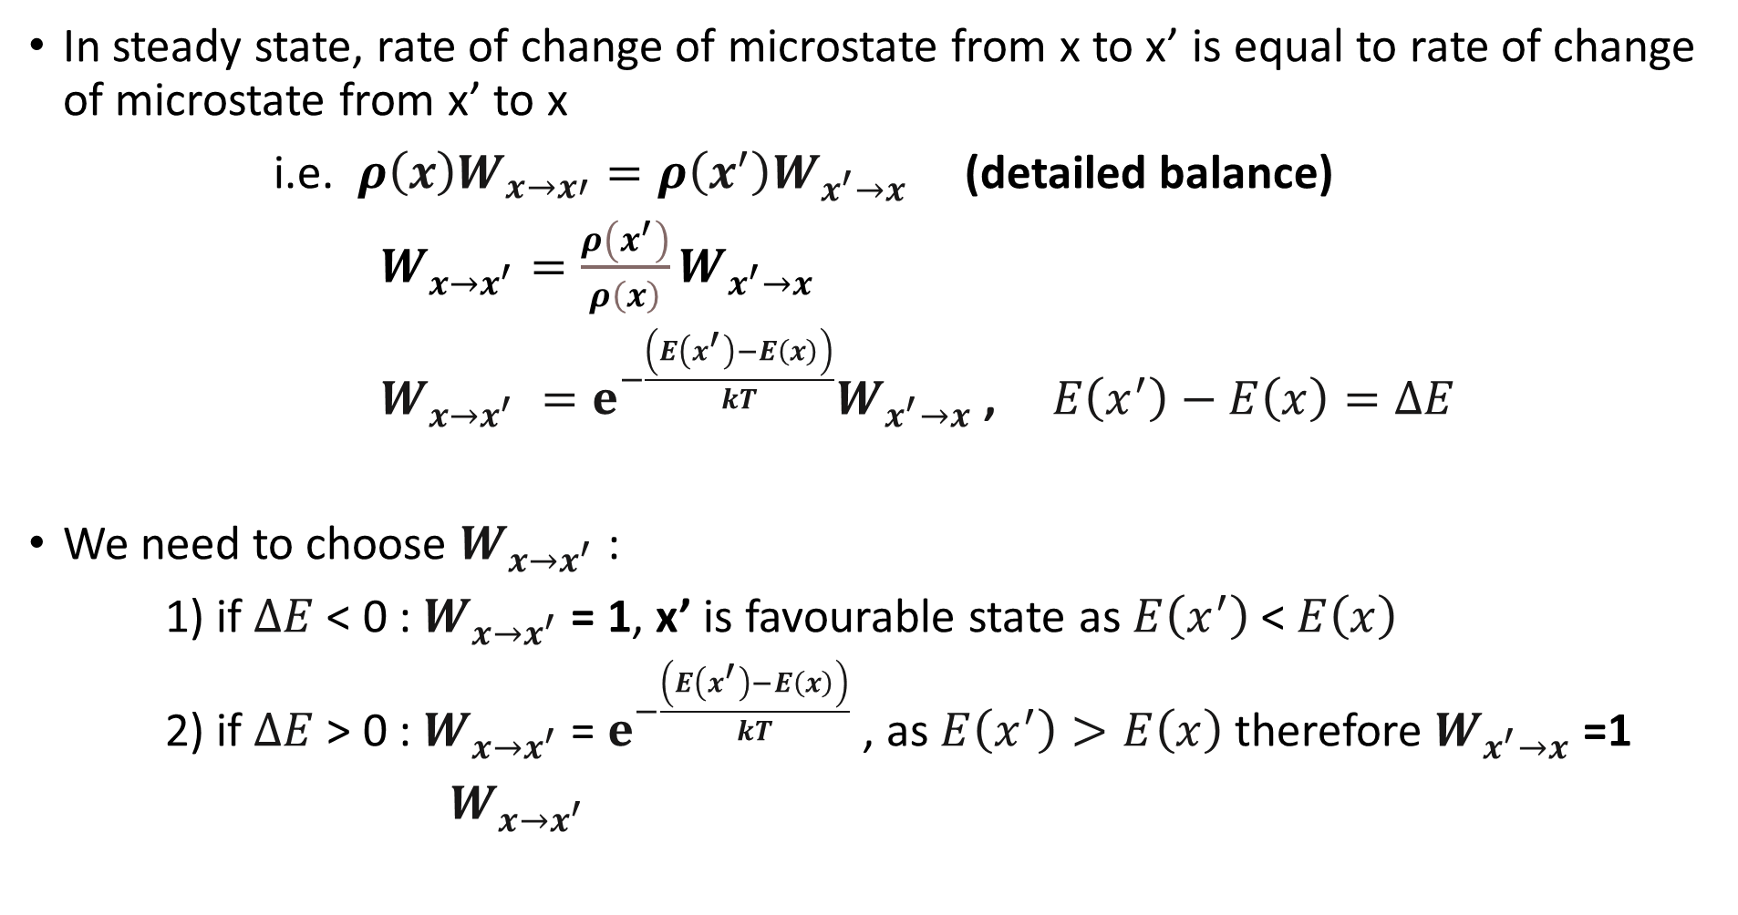
In steady state, rate of change of microstate from x to x’ is equal to rate of change of microstate from x’ to x
i.e. $ρ\left(x\right)W_{x→x′}=ρ\left(x^{′}\right)W_{x^{′}→x}$ (detailed balance)
$W_{x→x^{′}}=\frac{ρ\left(x^{′}\right)}{ρ\left(x\right)}W_{x^{′}→x}$
$W_{x→x^{′}} =ⅇ^{−\frac{\left(E\left(x^{′}\right)−E\left(x\right)\right)}{kT}}W_{x^{′}→x}$ , $E\left(x^{′}\right)−E\left(x\right)=ΔE$
We need to choose $W_{x→x^{′}}$:
1) if $ΔE$ < 0 : $W_{x→x^{′}}$ = 1, x’ is favourable state as $E\left(x^{′}\right)$ < $E\left(x\right)$
2) if $ΔE$ > 0 : $W_{x→x^{′}}$ = $ⅇ^{−\frac{\left(E\left(x^{′}\right)−E\left(x\right)\right)}{kT}}$ , as $E\left(x^{′}\right)>E\left(x\right)$therefore $W_{x^{′}→x}$ =1
$W_{x→x^{′}}$

Slide 11
ALGORITHMS FOR ISING MODEL
METROPOLIS ALGORITHM
WOLFF CLUSTER ALGORITHM

Slide 12
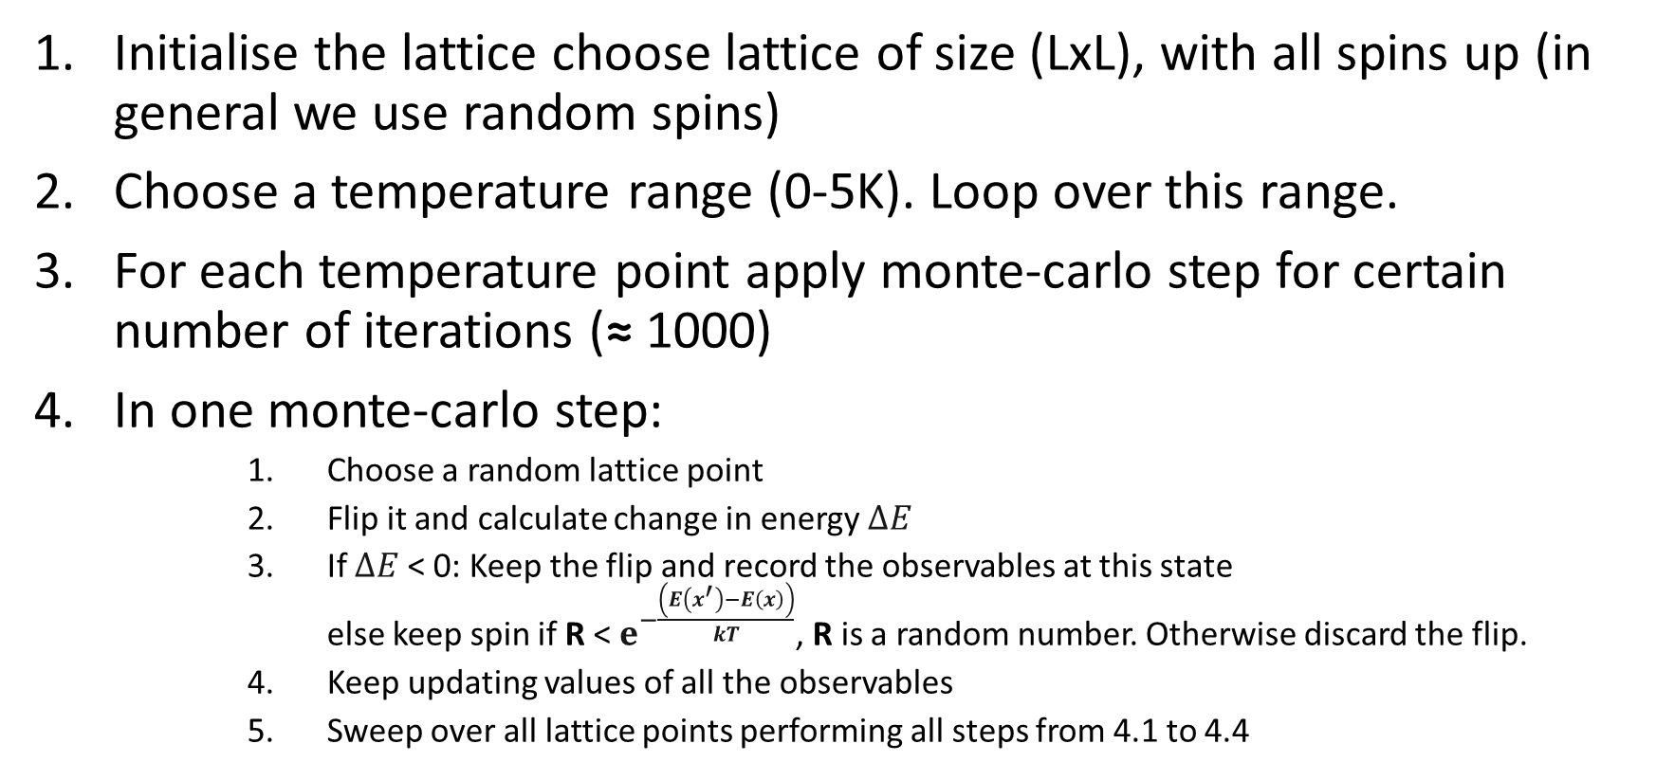
METROPOLIS ALGORITHM
Initialise the lattice choose lattice of size (LxL), with all spins up (in general we use random spins)
Choose a temperature range (0-5K). Loop over this range.
For each temperature point apply monte-carlo step for certain number of iterations (≈ 1000)
In one monte-carlo step:
Choose a random lattice point
Flip it and calculate change in energy $ΔE$
If $ΔE$ < 0: Keep the flip and record the observables at this state else keep spin if R < $ⅇ^{−\frac{\left(E\left(x^{′}\right)−E\left(x\right)\right)}{kT}}$, R is a random number. Otherwise discard the flip.
Keep updating values of all the observables
Sweep over all lattice points performing all steps from 4.1 to 4.4

Slide 13
PERIODIC BOUNDARY CONDITION(PBC)
Due to our low computation power we consider lattice to be made up of certain repeating structure in our case a matrix(grid) of spins. So the whole lattice can be obtained by placing these grids side by side infinitely many times.
Periodic Boundary condition ensures the behaviour of spins at the edges(boundaries) is same as spins not on boundaries maintaining the repetitiveness.
Applying PBC:
Let say we are interested in spin at (0,i) it has four nearest neigbour : (0,j-1),(0,j+1),(1,j),(-1,j)
The last neighbour at (-1,i) doesn’t exist in our grid, but we calculate (i,j) as i ≡ x(mod L) and j ≡ y(mod L), where x and y are position of nearest neighbors and i,j are position of nearest neighbor after applying PBC.

Slide 14
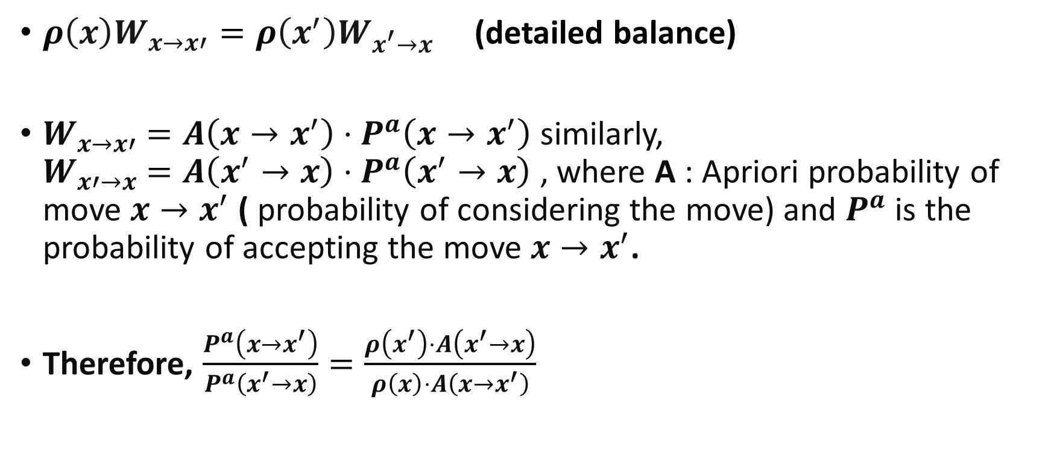
WOLFF’S ALGORITHM
$ρ\left(x\right)W_{x→x′}=ρ\left(x^{′}\right)W_{x^{′}→x}$ (detailed balance)
$W_{x→x′}$ $=A\left(x→x^{′}\right)⋅P^{a}\left(x→x^{′}\right)$ similarly, $W_{x′→x}$ $=A\left(x^{′}→x\right)⋅P^{a}\left(x^{′}→x\right)$ , where A : Apriori probability of move $x→x^{′}$ ( probability of considering the move) and $P^{a}$ is the probability of accepting the move $x→x^{′}$.
Therefore, $\frac{P^{a}\left(x→x^{′}\right)}{P^{a}\left(x^{′}→x\right)}=\frac{ρ\left(x^{′}\right)⋅A\left(x^{′}→x\right)}{ρ\left(x\right)⋅A\left(x→x^{′}\right)}$

Slide 15
LINKS TO WORK
https://courses.physics.illinois.edu/phys498cmp/sp2022/Ising/IsingModel.html
https://colab.research.google.com/github/rajeshrinet/compPhy/blob/master/notebooks/2014/IsingModel.ipynb
https://github.com/bdhammel/ising-model/blob/master/README.md

Slide 16
LINKS TO APPLICATIONS
https://mathoverflow.net/questions/413767/interesting-and-surprising-applications-of-the-ising-model
https://pubs.aip.org/aapt/ajp/article/76/4/470/1040239/Social-applications-of-two-dimensional-Ising
https://www.ncbi.nlm.nih.gov/pmc/articles/PMC9778161/

